Slide 1
Asynchronous FIFO
Sources:
Simulation and Synthesis Techniques for Asynchronous FIFO Design
Synthesis and Scripting Techniques for Designing Multi-Asynchronous Clock Designs
Clifford E. Cummings

Slide 2
Design specification
I/O defined
From 1 to 127 buffer size. Configurable with BUFFER_SIZE parameter
Area effective
Power effective
Fast

Slide 3
Alternative approaches
Binary pointers passed directly
Bad practice
Binary pointers with REQ/ACK handshaking signals
Safe and simple
Supports any fifo depth, and arbitrary pointer changes
Easy full/empty/almost_full/almost_empty generation
Smaller(2FF per pointer bits + 4 for REQ/ACK)
Higher latency(REQ/ACK signaling)
Possible all pointer bits change per increment
Gray code pointers passed directly
Proven design
Requires power-of-2 fifo depth(most dual-port ram is power-of-2 words deep)
Trickier full/empty /almost_full/almost_empty generation
Larger(4FF per pointer bits)
Lower latency(better performance if full/empty conditions happen often)
Maximum of 1 pointer bit value change per increment

Slide 4
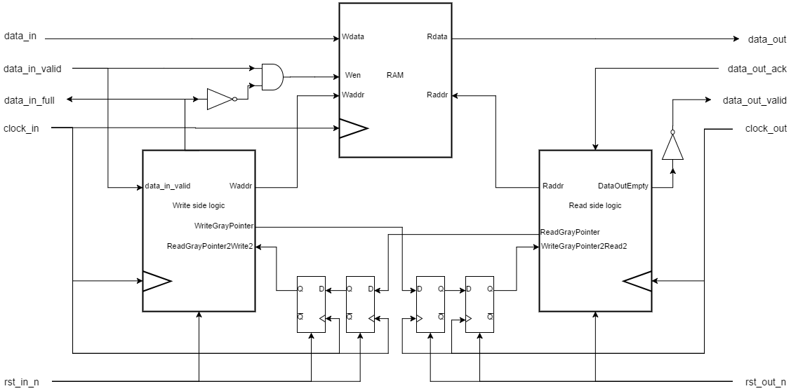
My implementation:

Slide 5
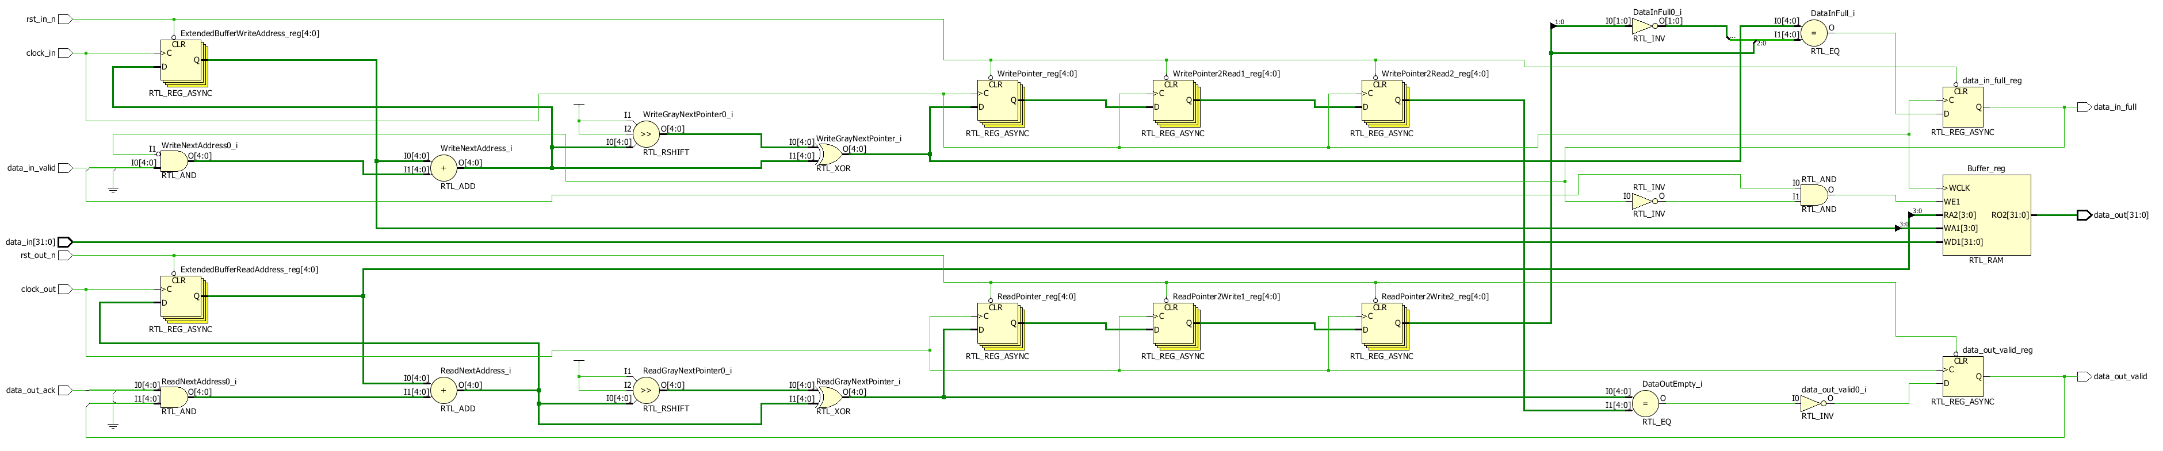
RTL Analysis

Slide 6
Synthesized design performance

Slide 7
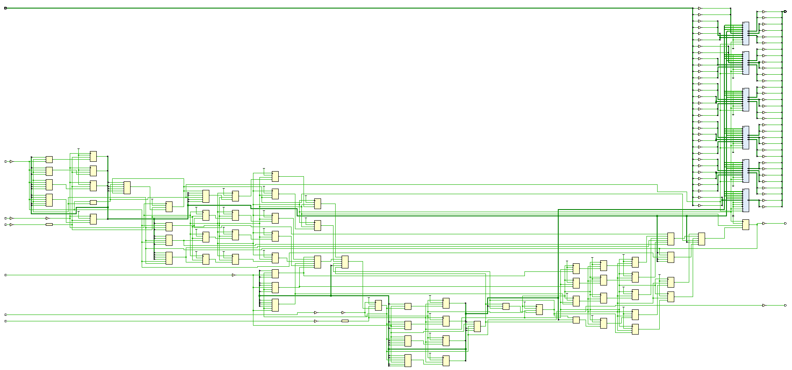
BUFFER_SIZE = 16

Slide 8
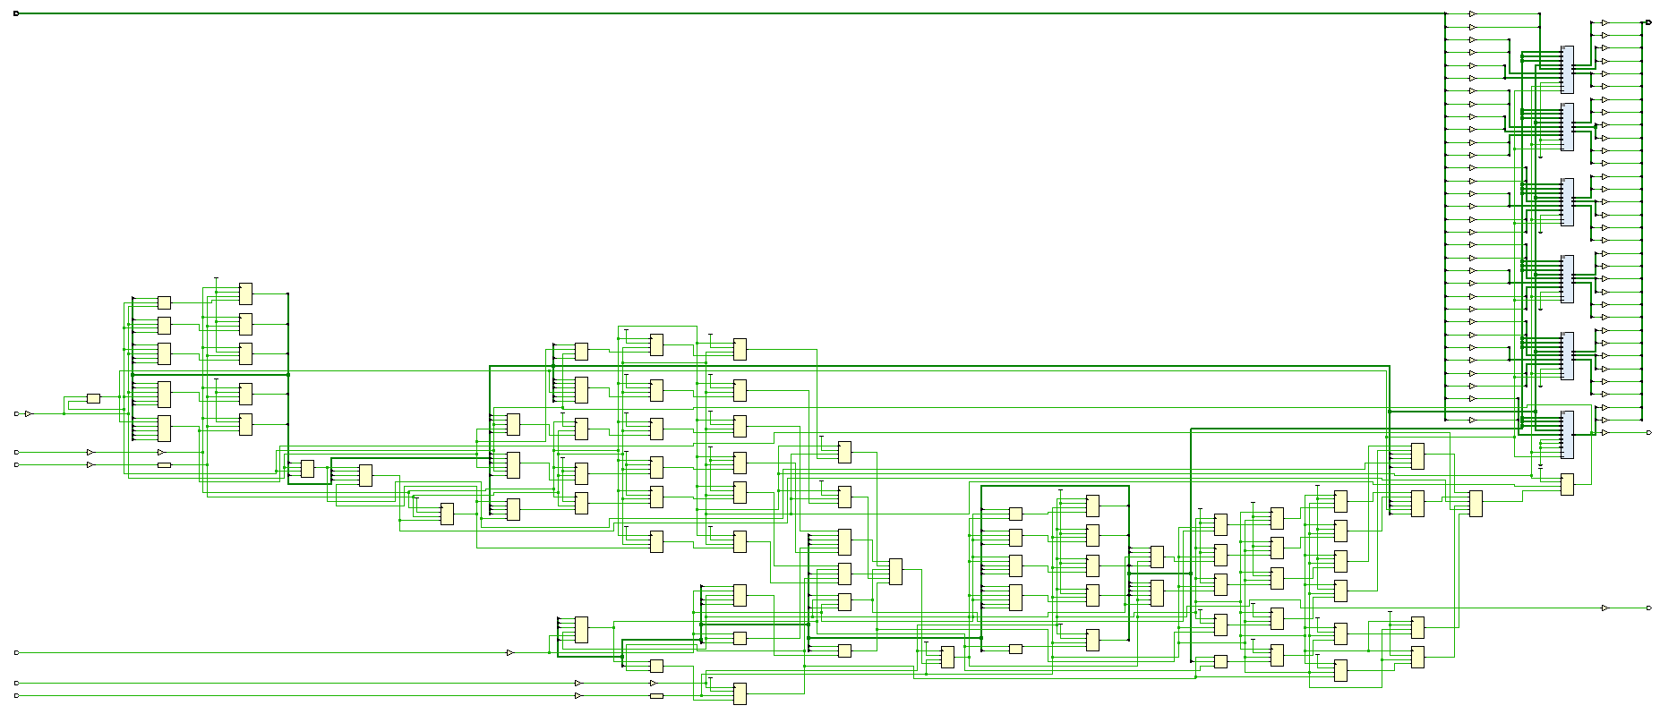
BUFFER_SIZE = 32

Slide 9
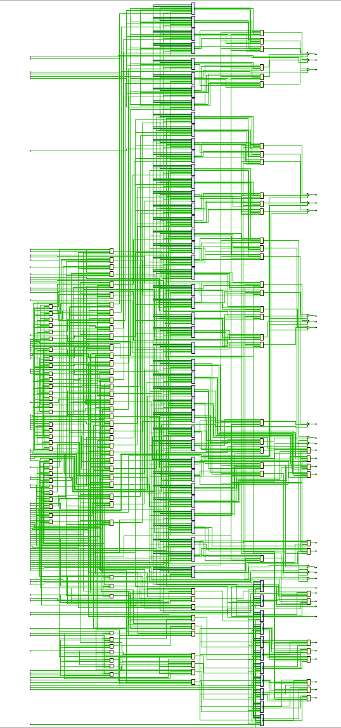
BUFFER_SIZE = 65536

Slide 10
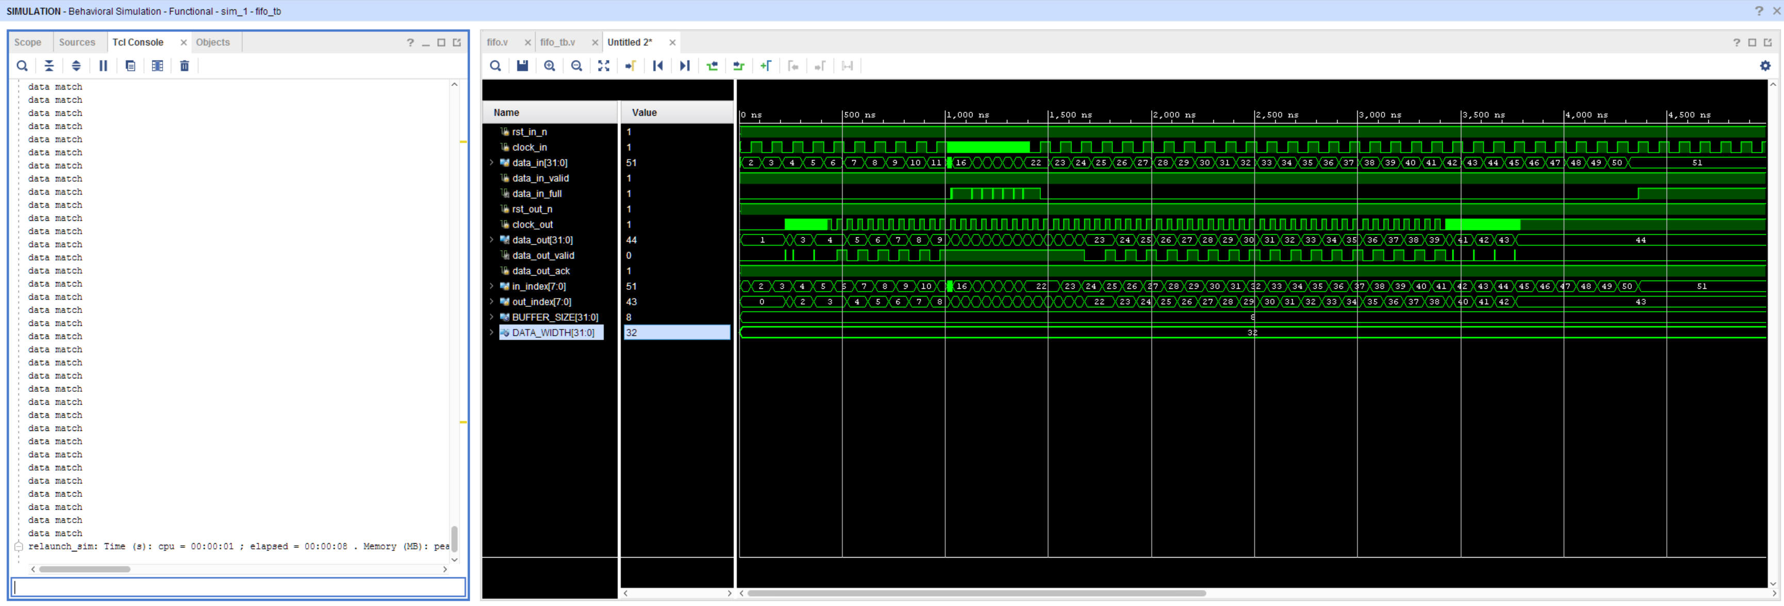
Simulation and Testbench (BUFFER_SIZE = 8)

Slide 11
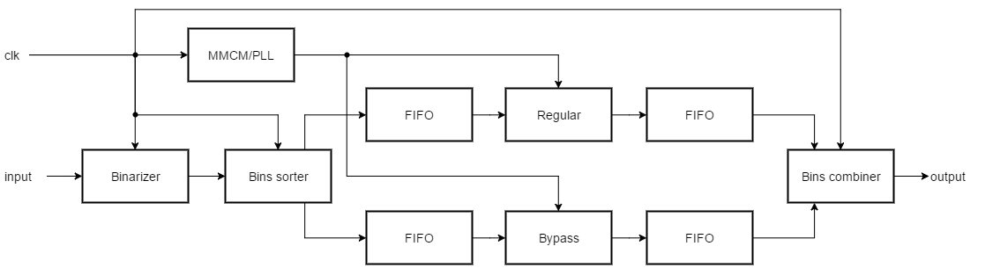
Integrated with HEVC Entropy coder

